Slide 1

How do Organisms
Reproduce?
Development and child birth

Slide 2
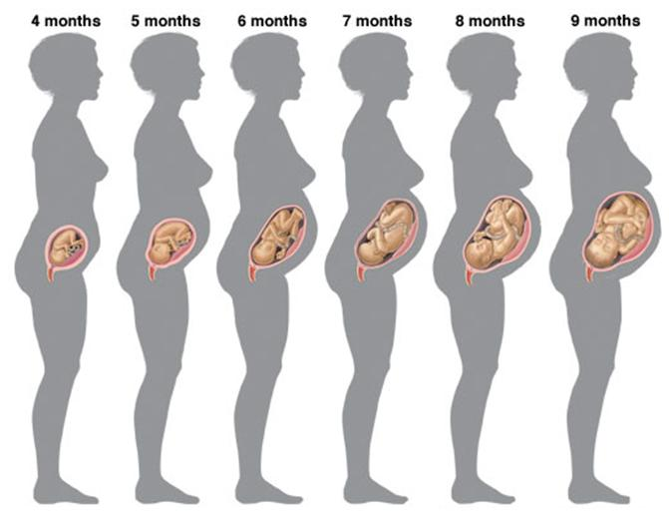
Female Reproductive System
We have already studied that the mother’s body is designed to undertake the development of the child.

Slide 3
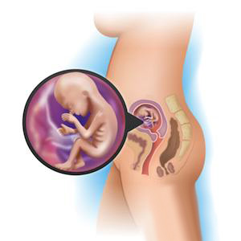
Female Reproductive System
Hence the uterus prepares itself every month to receive and nurture the growing embryo.

Slide 4
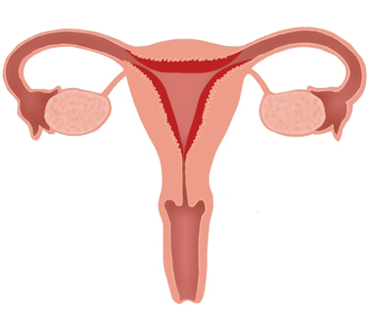
Female Reproductive System
The lining thickens and is richly supplied with blood to nourish the growing embryo.

Slide 5
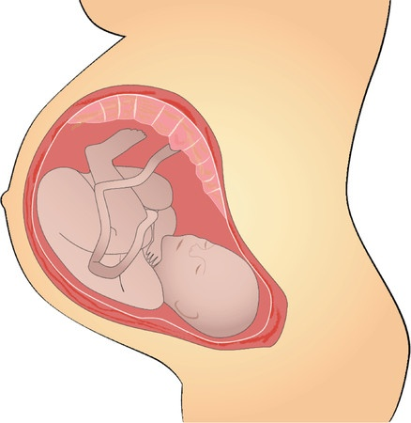
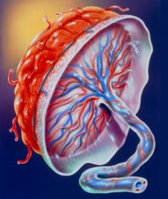
Female Reproductive System
The embryo gets nutrition from the mother’s blood with the help of a special tissue called ‘placenta’.
This is a disc which is embedded in the uterine wall.
Placenta

Slide 6
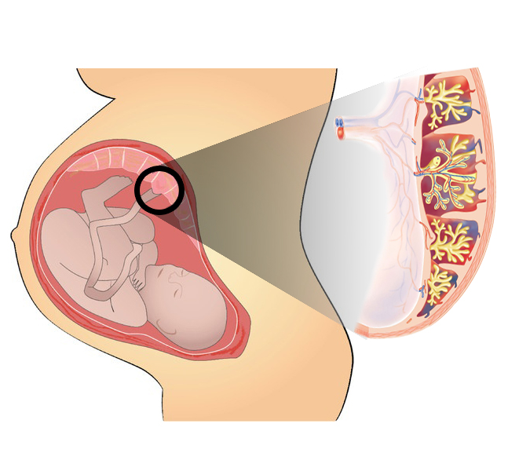
Female Reproductive System
Placenta contains villi on the embryo’s side of the tissue.
Finger-like projections
Villi
Placenta

Slide 7
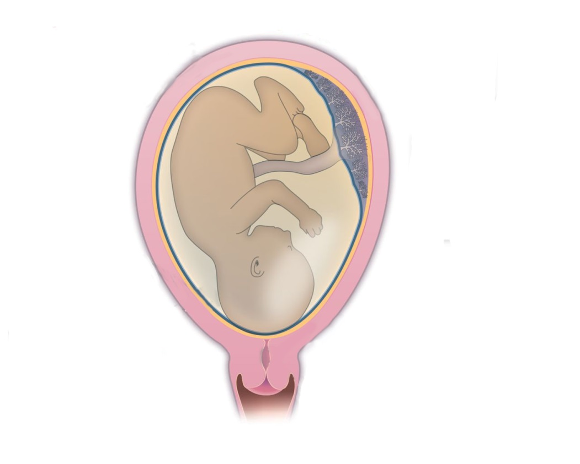
Female Reproductive System
On the mother’s side are blood spaces, which surround the villi.
This provides a large surface area for glucose and oxygen to pass from the mother to the embryo.
Maternal
Foetal

Slide 8

Female Reproductive System
On the mother’s side are blood spaces, which surround the villi.
This provides a large surface area for glucose and oxygen to pass from the mother to the embryo.
Maternal
Foetal
Glucose
O₂
Placenta

Slide 9
Female Reproductive System
The developing embryo will also generate waste substances which can be removed by transferring them into the mother’s blood through the placenta.
Like carbon dioxide (CO₂)
Maternal
Foetal
CO₂
Placenta

Slide 10
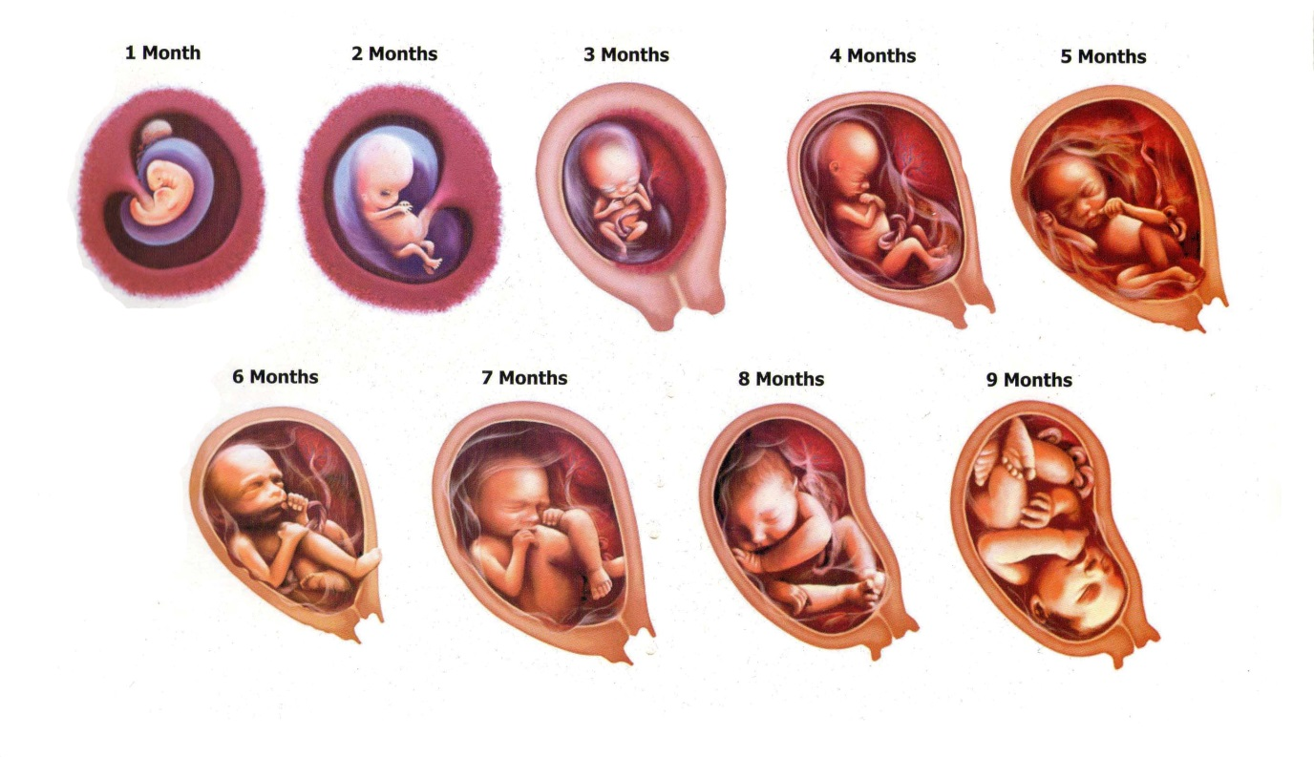
Female Reproductive System
The development of the child inside the mother’s body takes approximately nine months.

Slide 11
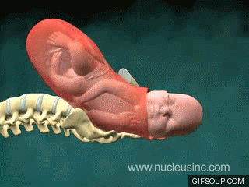
Female Reproductive System
The child is born as a result of rhythmic contractions of the muscles in the uterus.

Slide 12
Thank You

